Slide 1
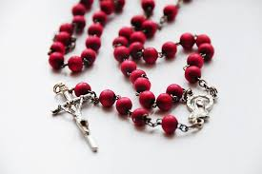
Rosary Mtakatifu

Slide 2
Ayie Nyasaye Wuon
Ayie Nyasaye Wuon Manyalo gikmoko duto jachwech polo gi piny.
Gi Jesus Kristus Wuode mamiderma Ruodhwa.
Manomak ichne kuom Chun Matakatifu,Bikira Maria ema nonywole.
Manosande kuom Pontius Pilato, manogure e musalaba,manotho.
Manoyike,nolor e limbo, chieng’ mar adek nochier kuom jomotho.
Nodum e polo, obet e lwedo ma kor achwich mar Nyasaye Wuon Manyalo gikmoko duto.
Kama noaye koduogo yalo jomangima gi jomotho

Slide 3
Ayie Chuny Mtakatifu,Eklesia makatholik Matakatifu, riwruok mar jotakatifu, golo mar maricho, chier mar ringruok, gi ngima ma okrum. Amen.

